Slide 1
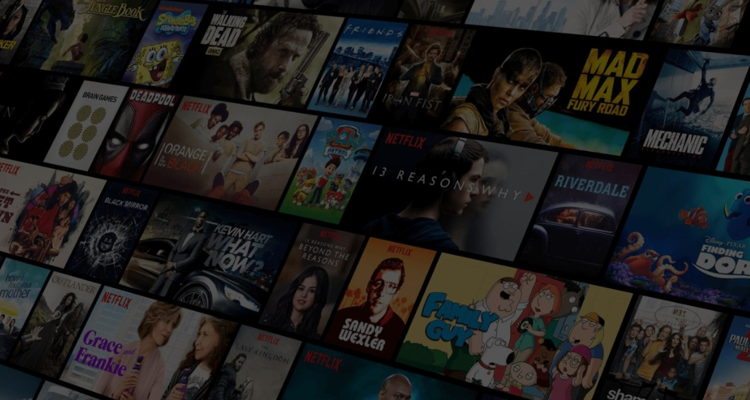
Project Team Members
Hezron Rumenya
Eric
Joackim Kisienya
Joy Sila
Newton Kyalo
Lynn Kyalo
MOVIE RECOMMENDATION SYSTEM

Slide 2

Business Overview
The world of streaming has transformed how we consume entertainment.
Unlike the traditional television model - shows are limited and scheduled,
Streaming services – Offer enormous library of movies and series at the click of a button.
Abundance creates its own problem - users often feel lost.
Think about the last time you opened a streaming platform.
Did you spend minutes scrolling through endless titles without finding anything? This is called decision fatigue.
The more options available, the harder it becomes to choose, and the overall experience suffers.
A recommendation system solves this issue by acting like a personal assistant inside the platform.
It studies what you like, compares you to similar users, and suggests content tailored just for you.
Instead of browsing through thousands of movies, you are presented with a shortlist that matches your unique taste.
In this project, we demonstrate how such a system can be built.
Using real user data from MovieLens,
We create a model that delivers personalized recommendations, ensuring that users not only find enjoyable content but also stay engaged with the platform over time.

Slide 3
Business Problem
The business challenge we seek to address is simple yet crucial:
How can we deliver personalized movie recommendations that increase user satisfaction and retention on a streaming platform?
The market has multiple streaming services that compete for attention
User experience is the deciding factor.
If users cannot easily find what they want to watch, they may abandon the platform altogether.
The two main challenges are:
Helping users discover content they love in a quick and effortless way.
Keeping users engaged over time by continuously offering fresh and relevant suggestions
Without an effective recommendation system
Platforms risk overwhelming their users,
Leading to lower engagement and higher churn (when users cancel their subscription).
On the other hand, a well-designed system improves
Satisfaction,
Strengthens loyalty, and
Directly impacts revenue.

Slide 4
Project Objective
Dataset Overview
The main goal of this project is to build a movie recommendation system using the MovieLens dataset.
Our objectives are:
Analyze user ratings and preferences.
Develop models that can predict what each user is likely to enjoy.
Deliver Top 5 personalized movie recommendations that feel relevant and engaging.
By doing this, the system will improve user satisfaction, increase watch time, and boost platform retention.
The dataset comes from MovieLens and includes four CSV files:
links.csv → movie identifiers linking to external sources.
movies.csv → movie titles and genres.
ratings.csv → user ratings for movies.
tags.csv → user-generated keywords or tags for movies.
Together, these files provide a strong foundation for building a recommendation system by capturing user behavior, movie details, and connections between them

Slide 5





Stakeholders
Product Owner
Marketing Team
Recommendation Systems
Product Team
Data Scientist

Slide 6
Data Cleaning and preparation
To ensure the dataset was ready for building a recommendation system, several preprocessing steps were applied:
Removed outliers → Ensured all ratings fall within the valid range of 0.5 to 5.0.
Fixed inconsistencies → Converted data types for user IDs, movie IDs, and ratings to the correct formats (integers and floats).
Normalized ratings → Scaled rating values so they are comparable and consistent across users.
Encoded genres → Transformed movie genres into numerical form using one-hot encoding, making them usable for modeling.
Extracted release year → Pulled the year of release from movie titles for better feature analysis.
Engineered new features:
Number of ratings per movie (popularity measure).
Average rating per movie (quality measure).
Average rating per user (user rating behavior).
Merged the datasets into one unified table
After merging, cleaning, and feature engineering, the final dataset contained 5 rows × 963 columns, representing a rich set of attributes for building the recommendation system

Slide 7
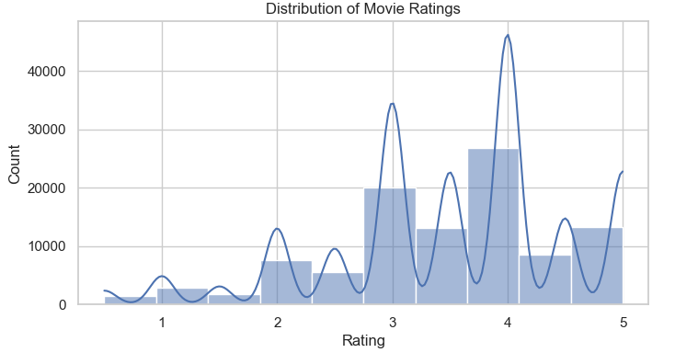
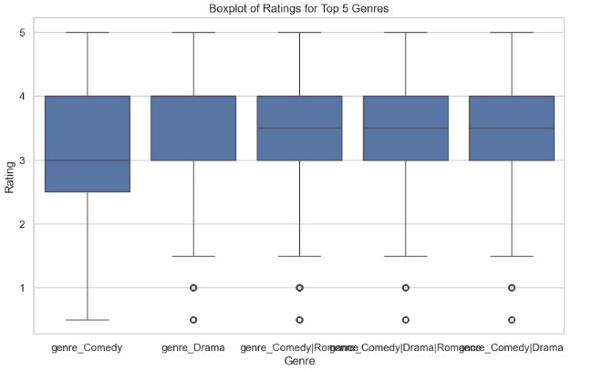
Exploratory Data Analysis
After completing the data cleaning process, we moved on to (EDA) to understand the structure and patterns in the dataset.
Key Observations for Distribution of Movie ratings
Most ratings are concentrated between 3 and 5, indicating a positive skew.
The highest peaks occur around ratings of 4 and 5, showing that users tend to give favorable reviews.
Very few movies receive ratings below 2, suggesting that low ratings are rare.
Takeaway:
The positive skew means that most movies are well-received, or users are generous with their ratings. Predictive models may need to account for this imbalance, as predicting high ratings will be easier than predicting low ones. The lack of low ratings may make it harder to distinguish truly poor movies Ratings are concentrated at the higher end, reflecting positive user sentiment and a tendency to give favorable reviews
Key Observations for ratings for top 5 genres
Comedy has the widest spread of ratings, indicating a more diverse audience reaction—from very low to very high.
Drama and genre combinations like Romance|Drama and Comedy|Drama show more consistent ratings, mostly clustered between 3 and 4.
All genres share a similar median rating around 3.5–4, consistent with the overall positive skew observed earlier.
Outliers (ratings below 2) are present across all genres, but are relatively few.
Takeaway:
Genres influence rating variability. Comedies appear more polarizing, while dramas and blended genres tend to have steadier audience reception.

Slide 8
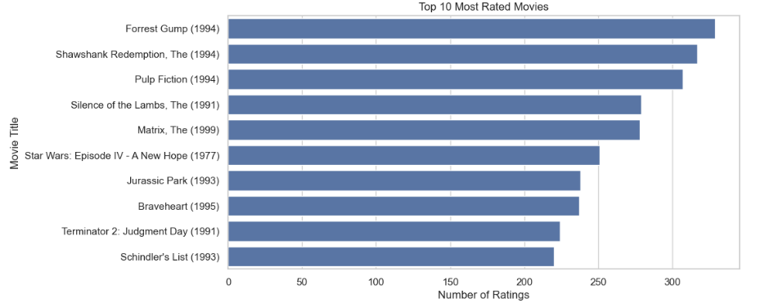
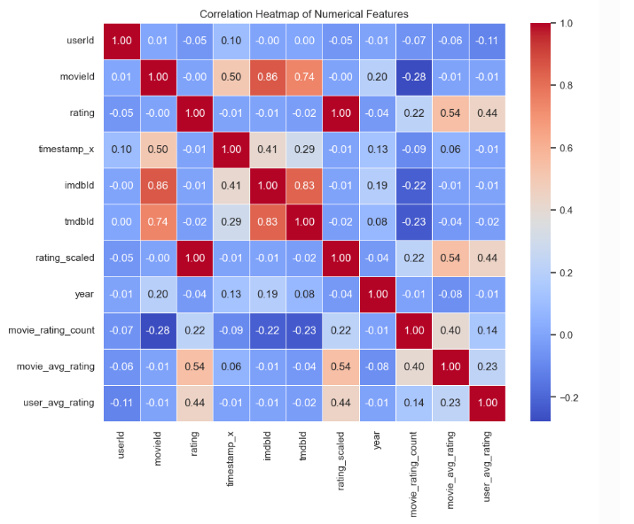
Key Observations & Takeaways from the bar chart
"Forrest Gump (1994)" received the most ratings Highly rated movies can act as strong baselines in recommendation systems.
Majority of top-rated movies are from the 1990s The dataset may have a temporal bias; older movies could be overrepresented.
Popular genres include drama, action, and sci-fi Genre preferences can inform content-based filtering models.
Ratings are unevenly distributed across movies Data imbalance must be addressed to prevent biased model predictions
Takeaways from Correlation Heatmap
Strong Positive Correlation Movies with higher average ratings tend to receive higher individual ratings (e.g., movie_avg_rating ↔ rating).
Feature Selection Insight Features that show strong correlation with the target variable (e.g., rating, high_rating) are likely to be important predictors for modeling.
Behavioral Pattern Users who usually give high ratings tend to maintain that behavior across movies (user_avg_rating ↔ rating).
Popularity ≠ Quality A movie's number of ratings (movie_rating_count) has low correlation with the rating itself,indicating popularity doesn't imply high quality

